Slide 1

Smart Nerd Dinner
Injecting Analytics To Your Application

Slide 2
AbOut Me
Jamie Dixon
F# MVP
BA in Economics + Political Science
BS in Computer Science
MPH – Epidemiology and Biostatistics
Data Scientist & Dev Lead
“Machine Learning Using .NET” 1Q 2016
@jamie_dixon

Slide 3
Goals For This Tutorial
Introduce F# to your code base on 12/9/2015. Production shortly thereafter
Refine/Retool your skills set for 2016
Think about the world differently
Have fun

Slide 4
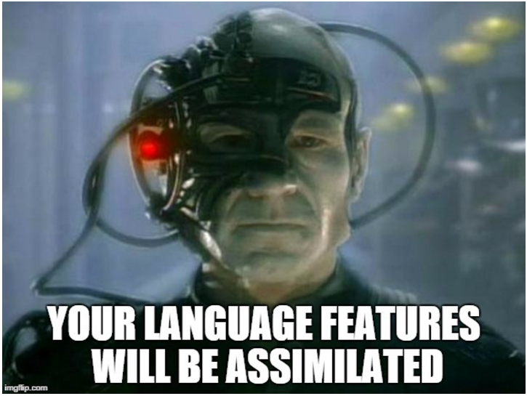
.NET 2017 Pivot Points
Pivot to the user (IoH)
WebDev: C#, Javascript, Angular, MVC5, basic UX
DesktopDev: C#, WPF, MVVM, basic UX
Pivot to the data
Data Scientist: F#, R, basic ML
Analyst: Usql, PowerBI
Pivot to the device (IoT)
C#, Raspberry Pi, Netdunino, UWA, basic robotics

Slide 5
Agenda
Data exploration and analysis
I show
You do
Azure Machine Learning
I show
You do
Beer

Slide 6
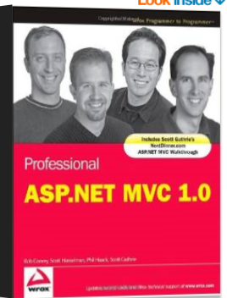
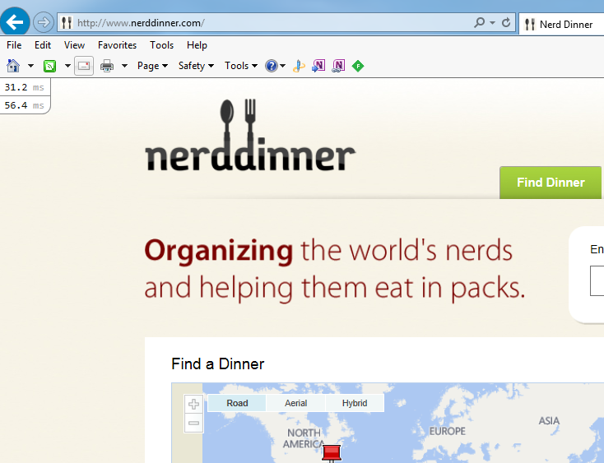
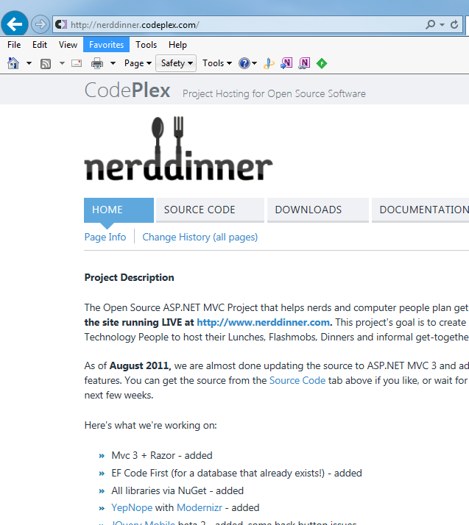
Nerd Dinner
MVC 1.0 Demo Project
MVC 2.0 – 4.0 Upgrades
Has own website that people are using
Source is on code plex

Slide 7
Nerd Dinner Details
No real business logic (basic input validation, some find dinner functionality)
Forms over data, wire-framing the database schema
What kind of business logic can we add?
Can we personalize the experience better?
Can we predict attendance better?

Slide 8
Site Personalization
We know some stuff via the browser
We know some stuff via Google/Bing analytics (Sign in or Inferred)
We know better stuff – the information they gave us when they registered
Inspired by Freakonomics podcast

Slide 9
Code
Install Visual Studio: https://www.visualstudio.com/en-us/products/vs-2015-product-editions.aspx
https://github.com/jamessdixon/NerdDinner

Slide 10
Predict Attendance
Simple averages?
Intro to Regression

Slide 11
Code

Slide 12
Predict Attendance
Azure ML

Slide 13
Code

Slide 14
Wrap Up
Use the right tool for the job
Java Script in the Browser
C# for UI work and domain classes
F# for Business Logic
F# for data access
Path To Data Science = Open Source + Open Education + Open Data + Open Mind
“Follow You, Follow Me” Genesis 1978

